Slide 1
SRF Science Meeting: Nb3Sn Recoating
Eric Viklund

Slide 2
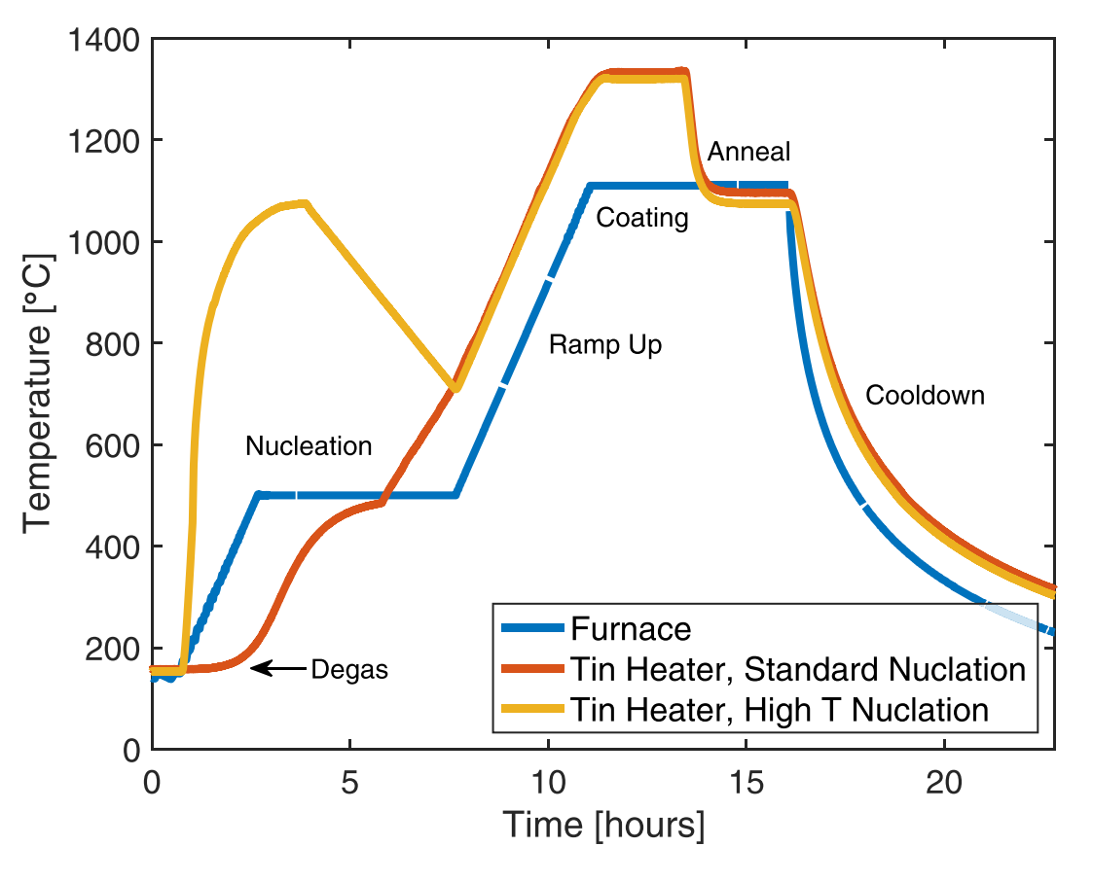
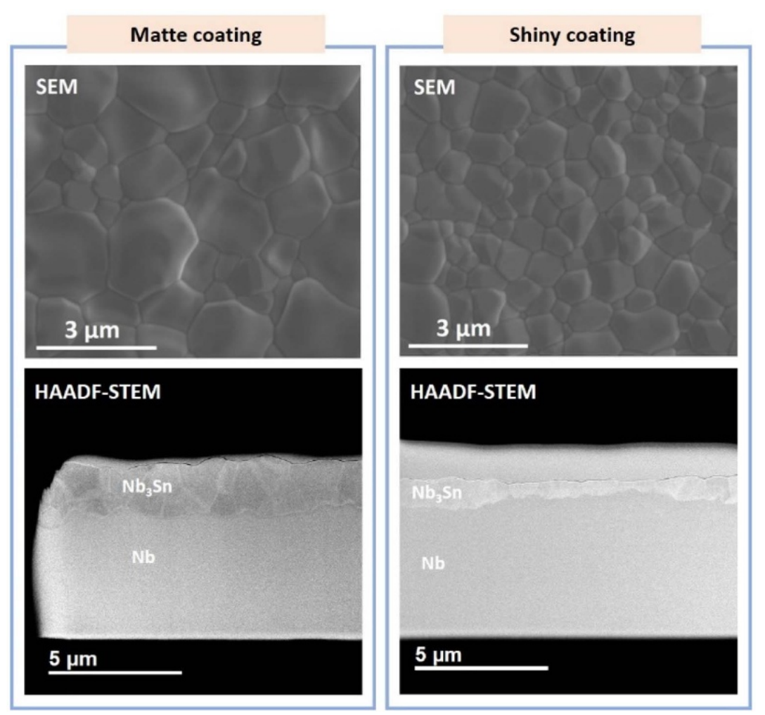
CBMMD-R
Coated using a modified high-temperature nucleation step resulting in a smoother, thinner Nb3Sn coating.
Was able to reach a record high accelerating gradient of 24 MV/m.
Performance was degraded in transport.
A recoating procedure was applied to the cavity to attempt to fix the degradation.
1000 ˚C for 1 hour
0.85 g of Sn
No SnCl2
S Posen et al 2021 Supercond. Sci. Technol. 34 025007

Slide 3
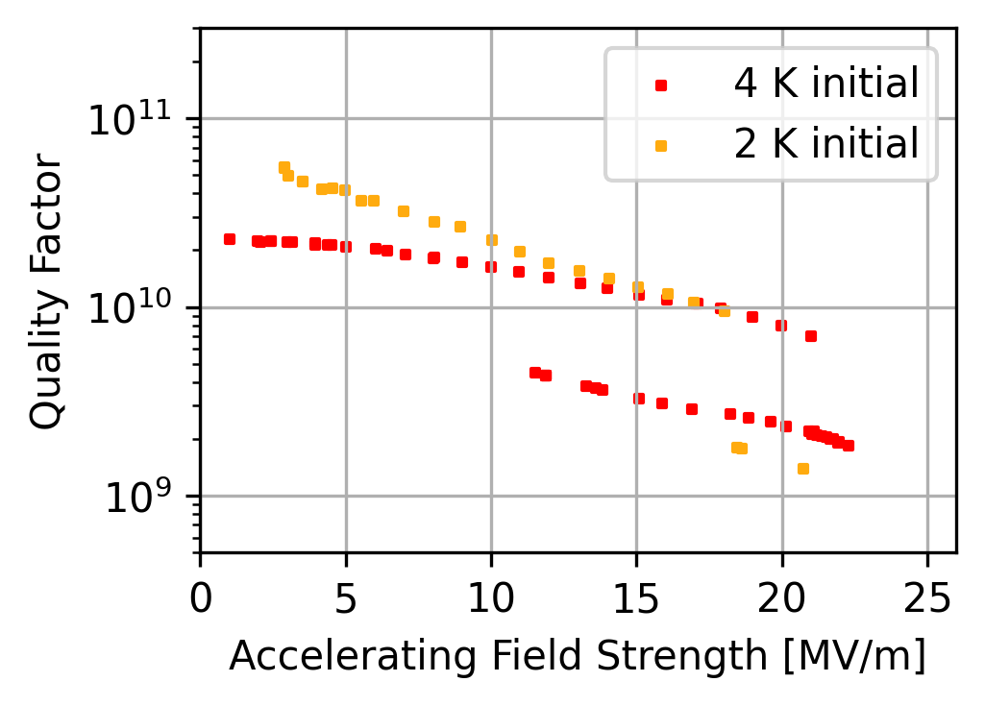
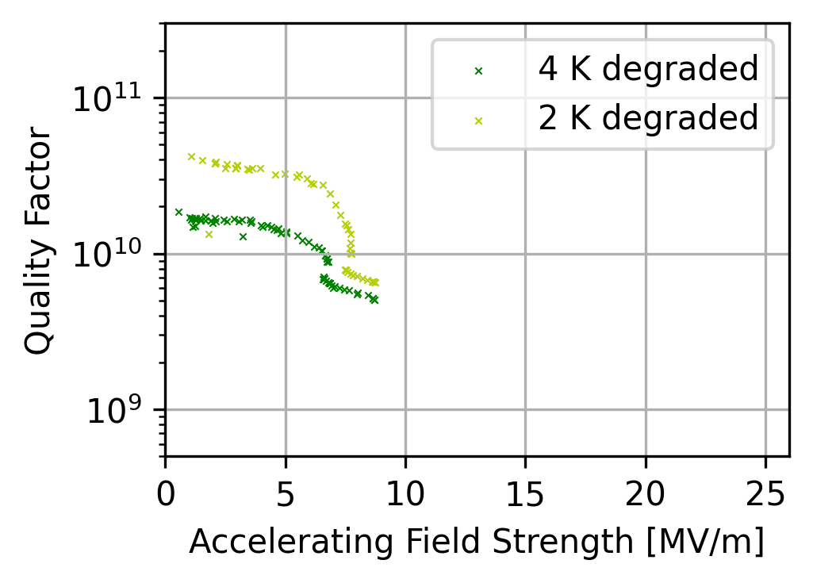
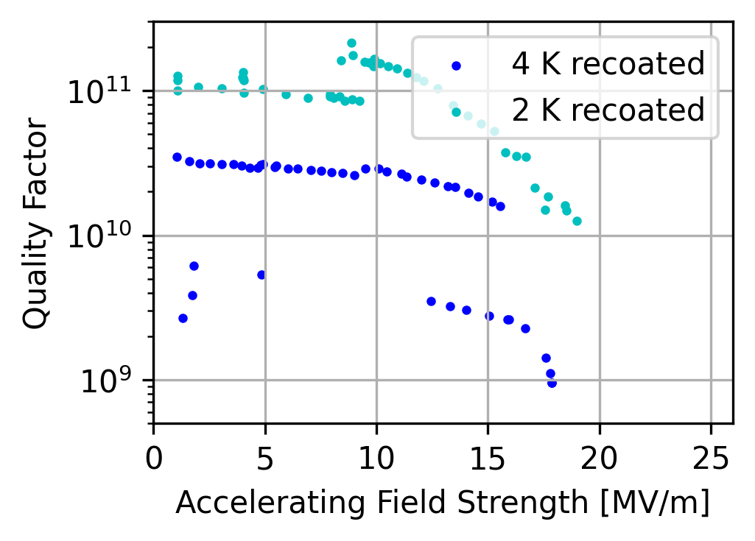
VTS Data
After the recoating, the cavity performance was greatly improved over the degraded performance but did not entirely recover the original performance.
Quench may be due to multipacting, so we will retest the cavity with T-mapping to attempt to reach higher gradients.

